Slide 1

Geocaching
T1W3 Part 1
RemWest

Slide 2
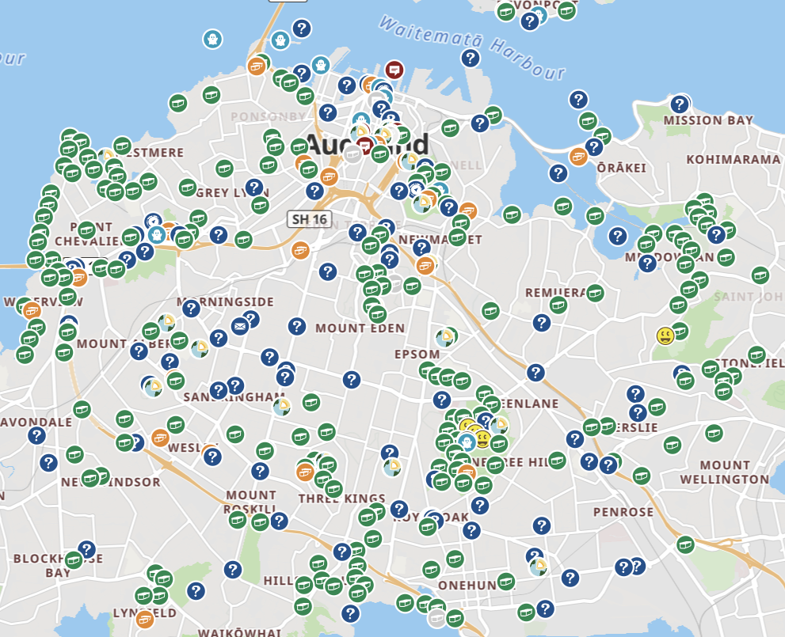
Geocaches in Auckland
Just a few...

Slide 3
What does a Cache look like?
There are multiple types of caches

Slide 4
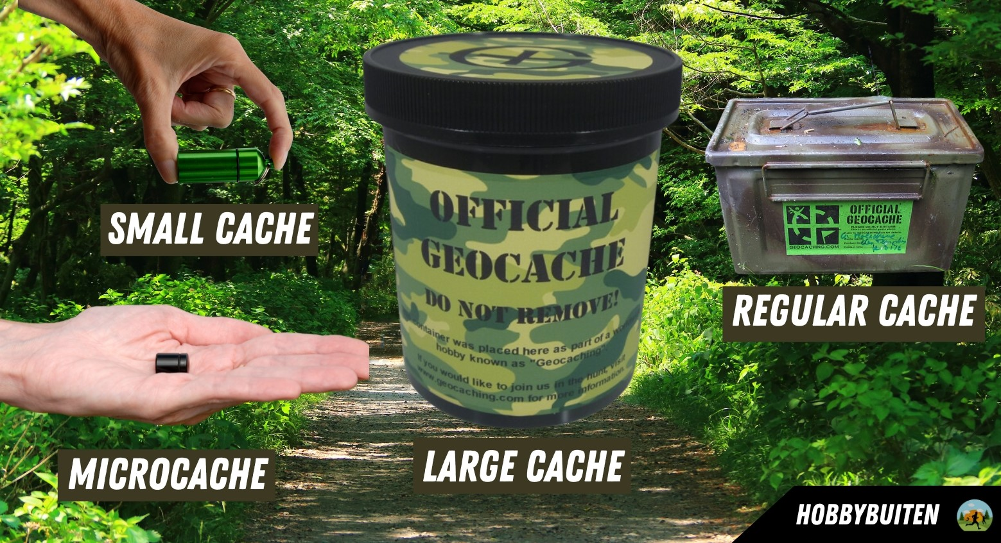
What does a Cache look like?

Slide 5
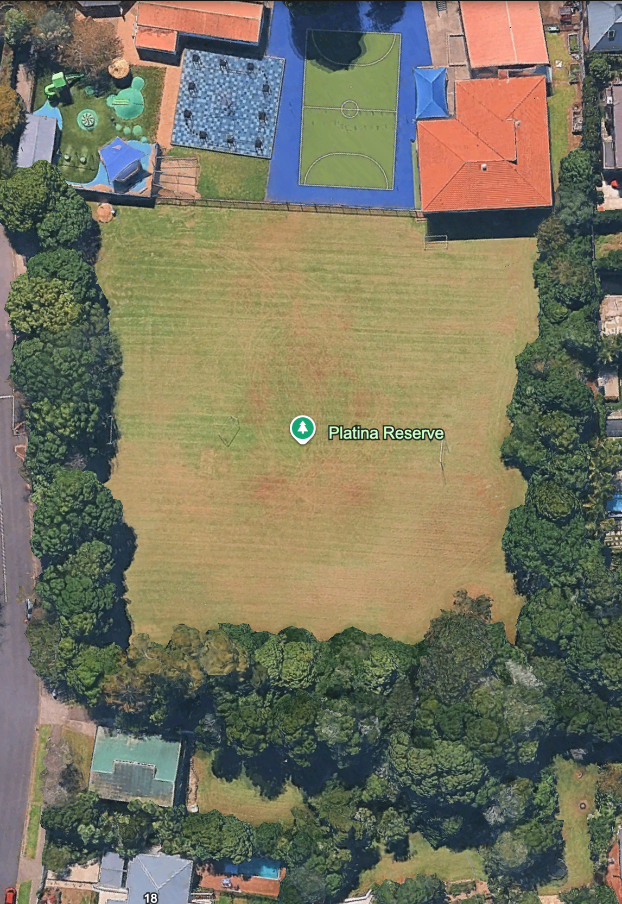
Our Area
If you couldn’t tell, this is a map of platina reserve.

Slide 6
Task time!
In your groups (on the next slide) you're going to do an activity on the next slide! (Bus Stop)

Slide 7
Generated Groups
[Eventtoolstrigger-groups]

Slide 8
How this will work
Half of you will be inside doing general geocache activities
Half of you will be outside
FINDING some geocaches
Then, you will ROTATE to the next activity

Slide 9
If you are good scouts
You will get to watch a video

Slide 10
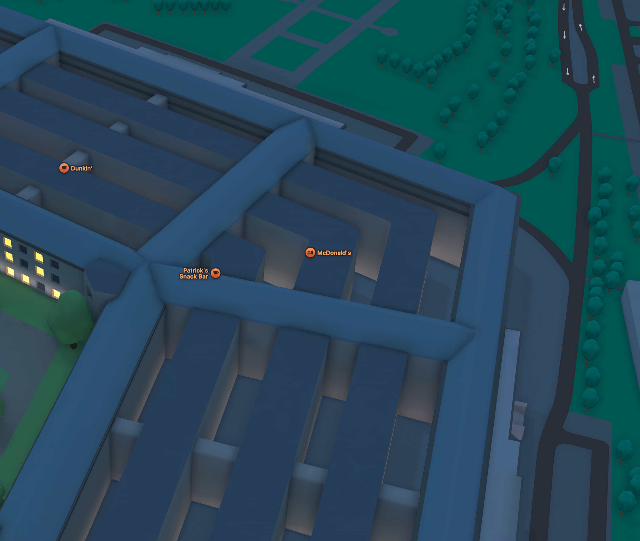

Task time!
Geocaches are hid around the field, see if you can find them!

Slide 11
Gadget Caches!
Gadget caches are more like a puzzle than a regular cache, lets do one together!

Slide 12
Gadget Caches!
Four workmates decided to spend their lunch hour exploring different parts of the Auckland Domain. They met back at the Wintergardens an hour later to compare notes.
Priya walked through the Formal Gardens. "I found this amazing sculpture," she said. "It's a sundial, but it's mounted on a column. The Roman numerals go all the way around it."
Marcus explored near the museum. "I was looking at that war memorial — the one with the cenotaph. There's an inscription on it. I counted the words in the first line. There were seven."
Lily wandered down to the duck ponds. "I sat by the lower pond for a bit. I counted how many fountain jets were running in the middle. There were three."
Jordan checked out the band rotunda. "That wooden structure is cool. I walked around it counting the corner posts holding up the roof. Eight posts total."
Your challenge:
Each person's number represents one digit of the code:
Priya's number (highest numeral visible on the sundial)
Marcus's number
Lily's number
Jordan's number

Slide 13
Gadget Caches!
The code was 12738!
Lets do another!

Slide 14
Shane and Dean set four scouts a challenge during a den night: explore the den and report back with specific observations.
One was sent to check the kitchen pantry. "I found a can of spaghetti at the back," they said. "The best-before date was 2022."
Another was looking at the jamboree LED signs in the main area. "I counted the signs from jamboree."
Another checked teamreach. "Shane asked me to count how many nights were left in the term."
The last scout was organising the storage cupboard. "Dean told me to count how many gas bottles we had downstairs. There were twelve."
Your challenge:
Each scout's number becomes part of the code:
Expiry date
LED Signs
Number of nights left in the term
Gas Bottles

Slide 15
The code was 20223712

